Slide 1
P300 SPELLER
Apoorva Kumar
Harshita Priyadarshi
Kusum Joshi
Prerna Mohan

Slide 2
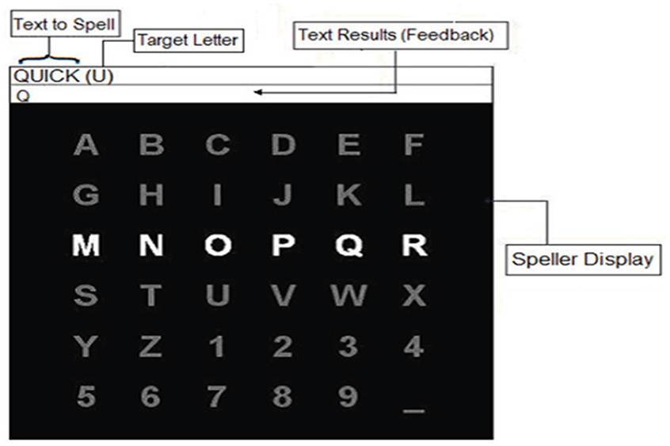
P300 SPELLER
The P300 speller is a type of brain writer that types characters using a P300 component derived from characters that flash randomly in a letter matrix (Farwell and Donchin, 1988).
A visual paradigm based P300 speller system consists of several stages: stimulating a subject by presenting a P300 display paradigm matrix; recording the EEG; signal preprocessing; feature extraction and classification.

Slide 3
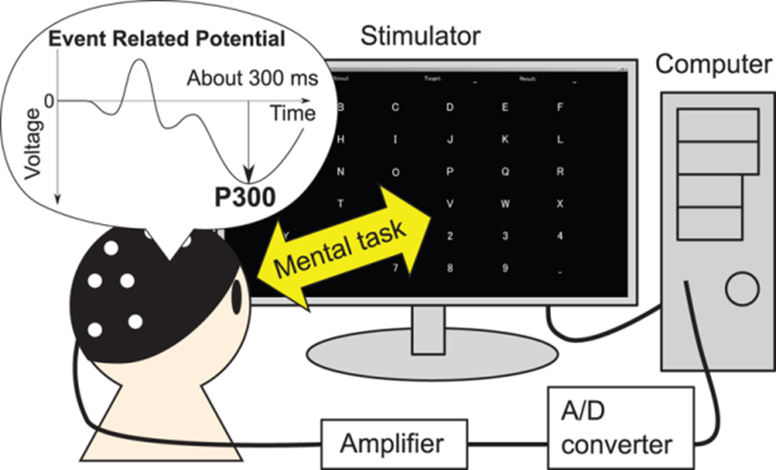
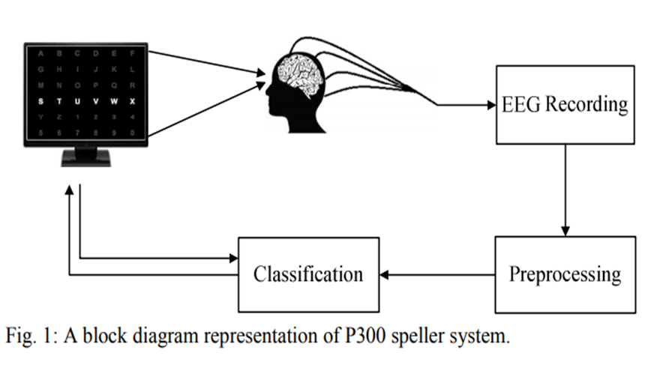
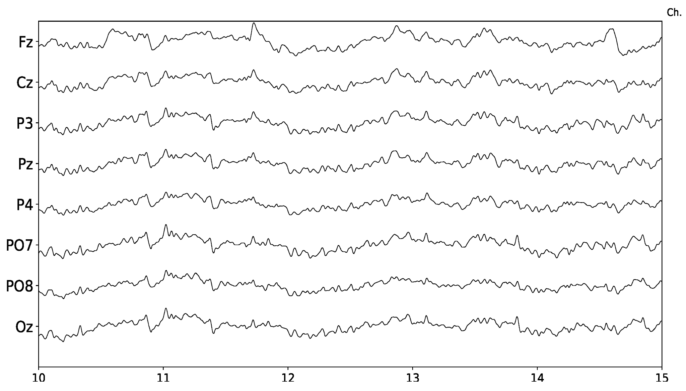

Slide 4
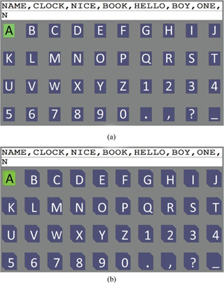
The 3-D P300 speller elicited higher amplitudes of P300 waveforms than the traditional 2-D P300 speller. The online experimental results showed that the classification accuracy and the ITR were significantly improved with the 3-D P300 speller. We also found that the user workload of the 3-D P300 speller was significantly lower than that of the 2-D P300 speller
3-D P300 SPELLER

Slide 5
Environmental setup
Mysql----- database
Heroku-----server
Node.js---backend
React---frontend
IMPLEMENTATION OF P300 SPELLER

Slide 6
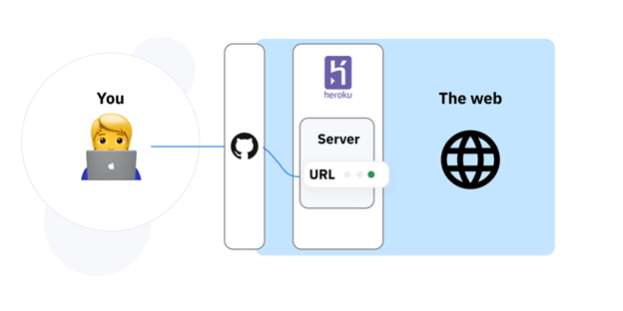
Heroku is a container-based cloud Platform as a Service (PaaS). Developers use Heroku to deploy, manage, and scale modern apps. Heroku is fully managed, giving developers the freedom to focus on their core product without the distraction of maintaining servers, hardware, or infrastructure.
HEROKU SERVER

Slide 7
NODE.JS
Node.js is an open-source, cross-platform, back-end JavaScript runtime environment that runs on the V8 engine and executes JavaScript code outside a web browser.JavaScript is a client-side language, but Node.js allows it to be used for server-side as well.
First step is to install npm.
Then we need to set up a tool called Express.
Then, we start the server using Express.
Deploying Application to Heroku

Slide 8
KNOWLEDGE REPOSITORY
A knowledge repository is an online database that systematically captures, organizes, and categorizes knowledge-based information. Knowledge repositories are most often private databases that manage enterprise and proprietary information.
Knowledge from all projects must be documented and collected.
This knowledge should be organized into a repository that will support decision making for future projects.
Organization should provide resources and funds for this activity.

Slide 9
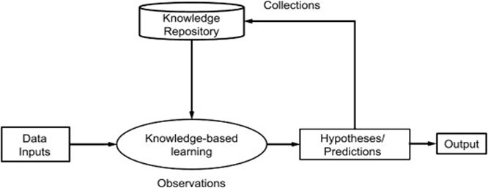
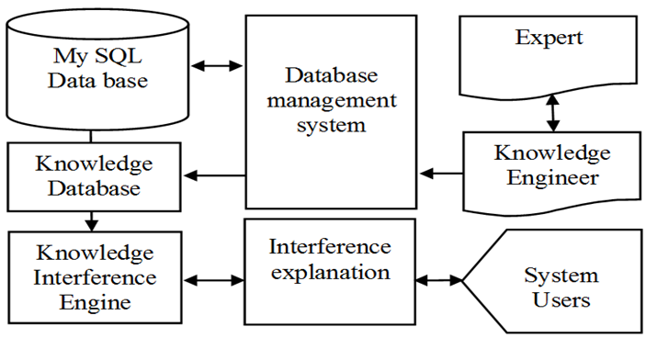

Slide 10
